Slide 1
Tomato Growth Model Variables
Variables Modeled:
Number Mature Fruit (N/m^2)
Mature Fruit Weight ((g/m^2)
Average Mature Fruit Size (g of dry weight)
Variables to determine:
Number of nodes
Density of plants (within GH)
Photosynthate
Photosynthesis done in a day
Ratio of biomass to roots
Daily maintenance respiration
Temperature
Development of fruit vs. avg. daily temp
Development time from first fruit to ripe fruit

Slide 2
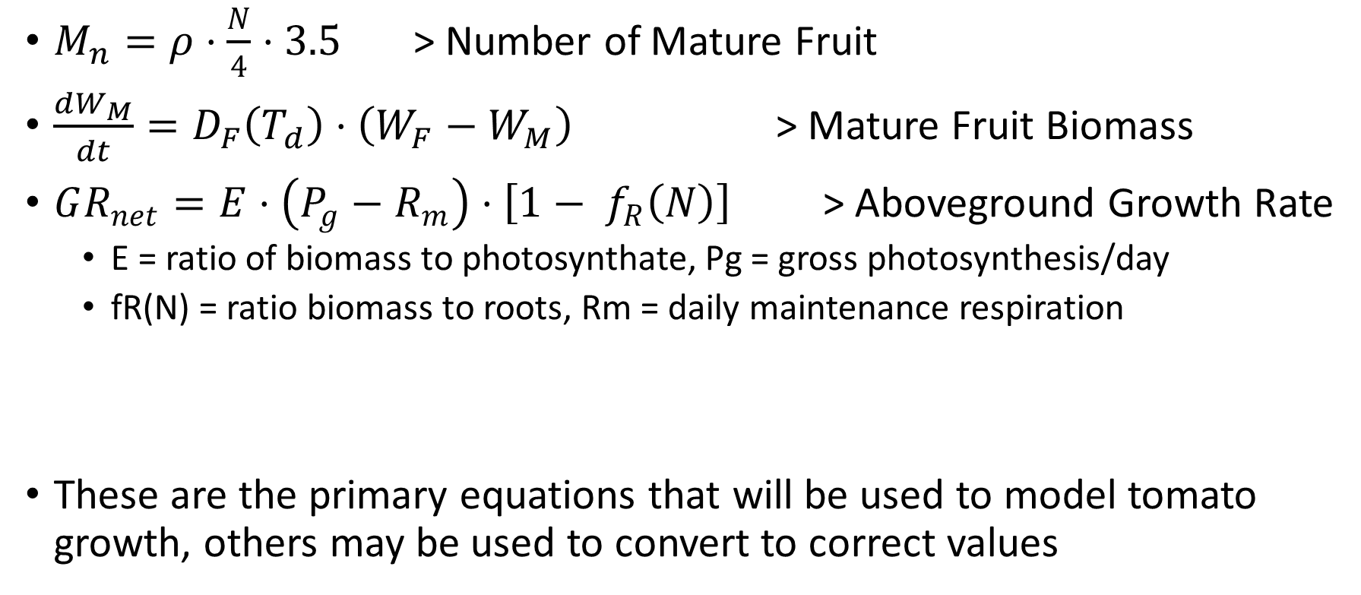
Equations with Parameters
$M_{n}=ρ⋅\frac{N}{4}⋅3.5$ > Number of Mature Fruit
$\frac{dW_{M}}{dt}=D_{F}\left(T_{d}\right)⋅\left(W_{F}−W_{M}\right)$ > Mature Fruit Biomass
$GR_{net}=E⋅\left(P_{g}−R_{m}\right)⋅\left[1− f_{R}\left(N\right)\right]$ > Aboveground Growth Rate
E = ratio of biomass to photosynthate, Pg = gross photosynthesis/day
fR(N) = ratio biomass to roots, Rm = daily maintenance respiration
These are the primary equations that will be used to model tomato growth, others may be used to convert to correct values

Slide 3
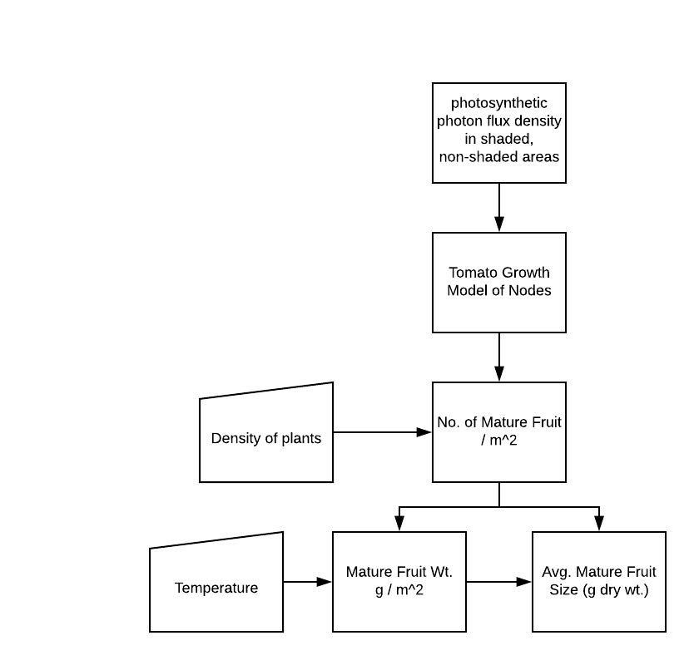
Flowchart

Slide 4
Timeline
Phase 1:
3-5 hours of research and developing initial modeling design
Phase 2:
10-15 hours working on initial program until functional
Phase 3:
5-10 hours finalizing program and preparing for final presentation

